Slide 1
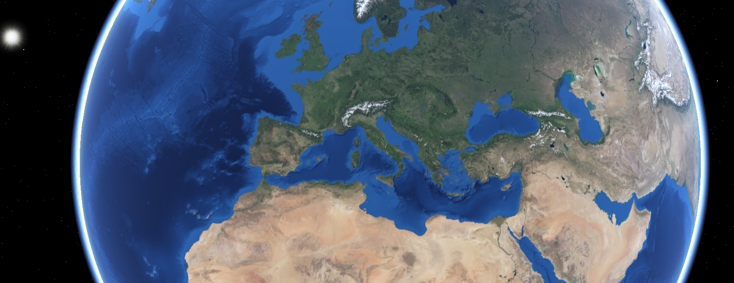

CS16 Group Project Research
By Adam Fairlie

Slide 2

Geoserver http://geoserver.org/
Map Servers
Seems to be the most widely used
OGC compliant
Good documentation and tutorials
https://docs.geoserver.org/
Support for python and JavaScript (among other languages)
https://docs.geoserver.org/stable/en/user/community/scripting/supported.html

Slide 3

Map Servers
Mapserver https://mapserver.org/
OGC Compliant
Seems more complicated to build a web application off
Less tutorials on how to implement certain features

Slide 4

Map Servers
PyGeoAPI https://pygeoapi.io/
Can be deployed via django (more familiarity)
Easy to use and install
OGC Compliant
May be harder to integrate with JavaScript code
More recent technology with less industry use so we may find less help for issues online

Slide 5

3D Web Front End
Cesium (JavaScript) https://cesium.com/platform/cesiumjs/
Seems very powerful for drawing 2d and 3d polygons:
https://www.safe.com/blog/2018/08/bring-2d-data-cesiumjs/
Compatibility with the open source APP-6 military symbol library:
https://github.com/spatialillusions/milsymbol
https://cesium.com/blog/2016/07/20/cesium-and-milsymbol/
Support for terrain such as SRTM:
https://cesium.com/platform/cesium-ion/content/cesium-world-terrain/
Can integrate with geoserver:
https://dale-bingham-cingulara.medium.com/a-cesiumjs-starter-kit-with-geoserver-a96bfe767ba2
Decent documentation for getting started and some features
https://cesium.com/learn/cesiumjs-learn/
Seems to also have 2D capabilities although these are not as clearly stated
https://live.osgeo.org/en/quickstart/cesium_quickstart.html#switch-between-3d-2-5d-and-2d

Slide 6

3D Web Front End
Worldwind (JavaScript) https://worldwind.arc.nasa.gov/web/
Definite support for 2D and 3D
Shapes and paths provided as a feature
Built-in high-resolution imagery and terrain
Support for layers
https://worldwind.arc.nasa.gov/web/tutorials/layers/
Seems to possibly be compatible with milsymbol, may be hard though
https://forum.worldwindcentral.com/forum/web-world-wind/web-world-wind-help/158429-dynamic-imagesource-in-the-placemark-attributes

Slide 7
3D Web Front End
Worldwind (JavaScript) https://worldwind.arc.nasa.gov/web/
Good official tutorials and documentation
https://worldwind.arc.nasa.gov/web/get-started/#anchor
https://worldwind.arc.nasa.gov/web/tutorials/#anchor
https://worldwind.arc.nasa.gov/web/docs/#anchor
https://worldwind.arc.nasa.gov/web/examples/#anchor
Possible compatibility with react.js to create a web app
https://github.com/WorldWindEarth/worldwind-react-globe

Slide 8
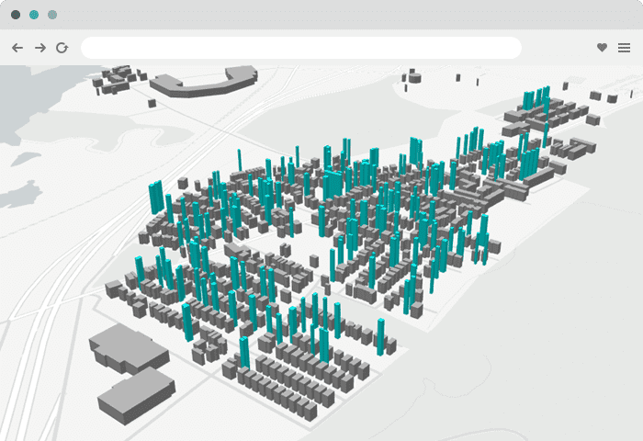
3D Web Front End
Maptalks (JavaScript) https://maptalks.org/
Support for 2D and 3D
Support for layers
https://github.com/maptalks/maptalks.js/wiki/Layer
Support for drawing lines and polygons
https://maptalks.org/examples/en/interaction/draw-tool/
No mention of OGC standards
Less extensive documentation/less widely used

Slide 9

3D Web Front End
Google Earth Enterprise (JavaScript) https://www.opengee.org/
OGC standard protocols
Has a lot of documentation
https://www.opengee.org/geedocs/5.3.8/index.html
2D, 3D and terrain capabilities
Less commonly used so likely less help available online
Probably harder to integrate with milsymbol

Slide 10

Live feeds
ADS-B Interface (JSON REST API) https://openskynetwork.github.io/opensky-api/rest.html#
Free to use
Can be used with AJAX probably
Can only search every 5 seconds

Slide 11
Other libraries
https://github.com/spatialillusions/milsymbol
JavaScript library for APP-6 symbols. Generates an SVG or canvas image for a specified symbol. Doesn’t require storing images as they are created by the library. Compatible with cesium and probably also worldwind or any JavaScript library
https://github.com/TimJMartin/Magic-GDAL
Data processing and translating for vector and raster data. Probably won’t be useful

